Slide 1
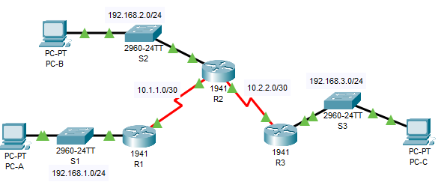
Configure Local AAA for Console and VTY Access

Slide 2
Configure Local AAA for Console and VTY Access
R1(config)# username Admin1 secret admin1pa55
R1(config)# aaa new-model
R1(config)# aaa authentication login default local
R1(config)# line console 0
R1(config-line)# login authentication default

Slide 3
Configure Local AAA for Console and VTY Access
R1(config-line)# end
%SYS-5-CONFIG_I: Configured from console by console
R1# exit
R1 con0 is now available
Press RETURN to get started.
************ AUTHORIZED ACCESS ONLY *************
UNAUTHORIZED ACCESS TO THIS DEVICE IS PROHIBITED.
User Access Verification
Username: Admin1
Password: admin1pa55
R1>

Slide 4
Configure Local AAA for Console and VTY Access
R1(config)# ip domain-name netsec.com
R1(config)# crypto key generate rsa general-keys modulus 1024
The name for the keys will be: R1.netsec.com
% The key modulus size is 1024 bits
% Generating 1024 bit RSA keys, keys will be non-exportable...[OK]
R1(config)# aaa authentication login SSH-LOGIN local
R1(config)# line vty 0 4
R1(config-line)# login authentication SSH-LOGIN
R1(config-line)# transport input ssh
R1(config-line)# end

Slide 5
Verify the SSH configuration SSH to R1 from the command prompt of PC-A.
PC> ssh –l Admin1 192.168.1.1
Open
Password: admin1pa55

